Slide 1
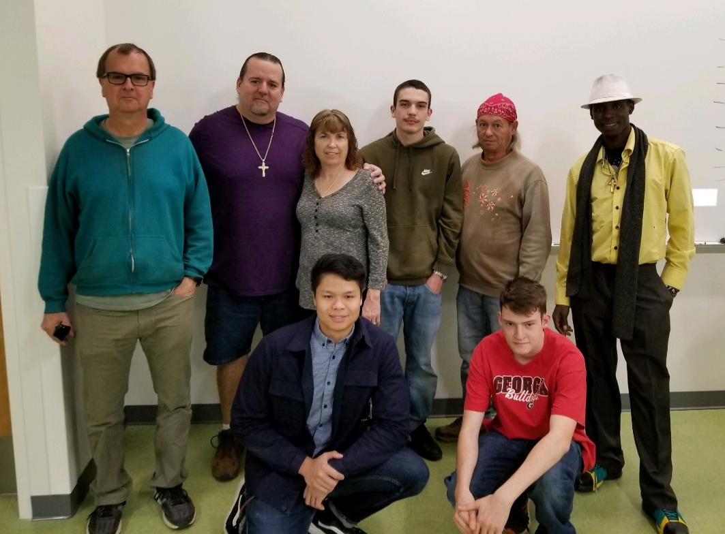
SPACE JUNKIES
Central Arizona College Fall Flight Results
Team Members: Michael Cabrera, Pamela Cabrera, Peter Mwangi, Julian Madrid, Daniel Barkley, Clayton Wood, Angelo Navoa, Professor Wayne Pryor

Slide 2
Our Goals….
To measure the Pressures, Temperature and Humidity levels as we rise into the stratosphere.
To get clear, precise views of the earth and horizon from the stratosphere and the Balloon burst event.

Slide 3
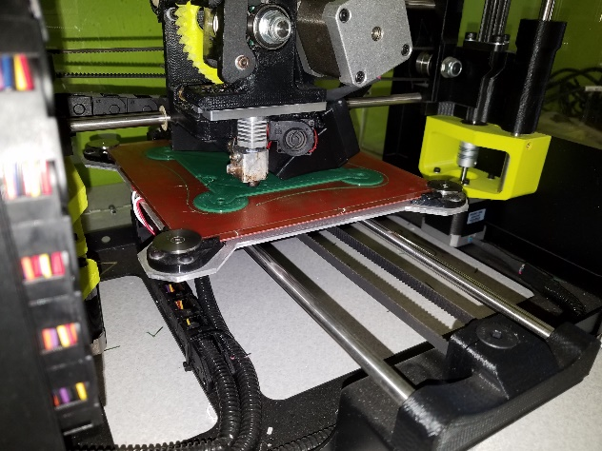
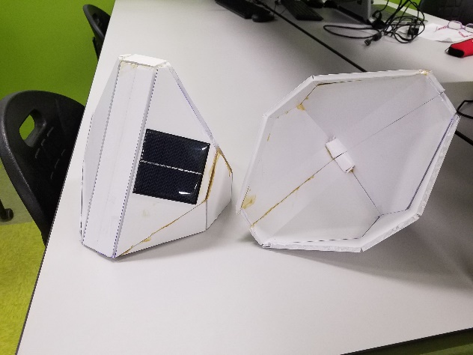
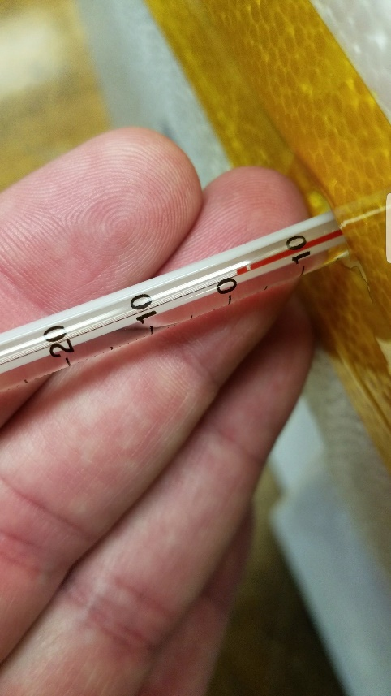
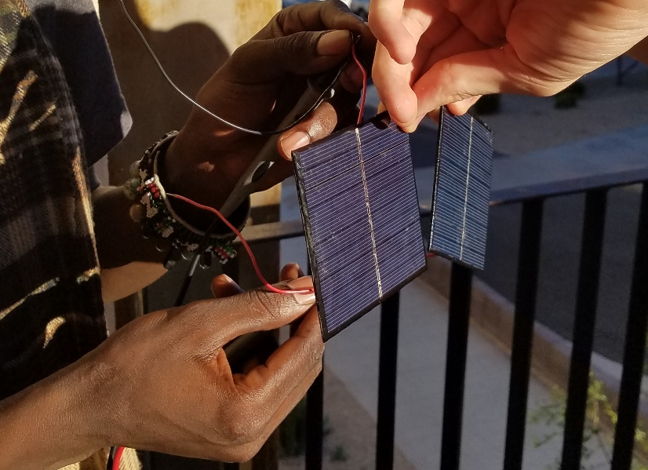
Material Testing and Development
Freezer Temperature Testing to -5 degree Fahrenheit
Battery longevity testing with multiple power sources
Solar panel implementation in flight and for recharging on board PI and mobius cameras

Slide 4
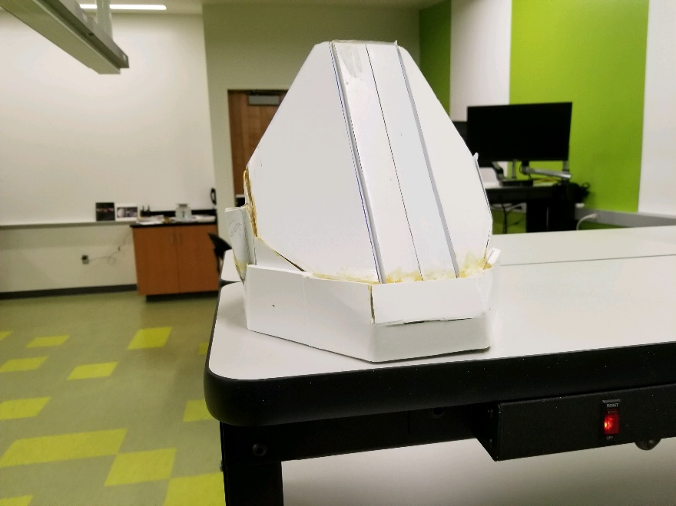
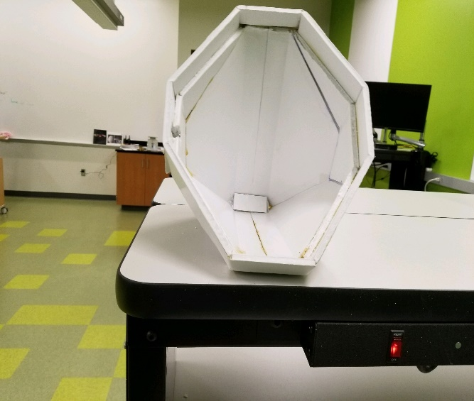
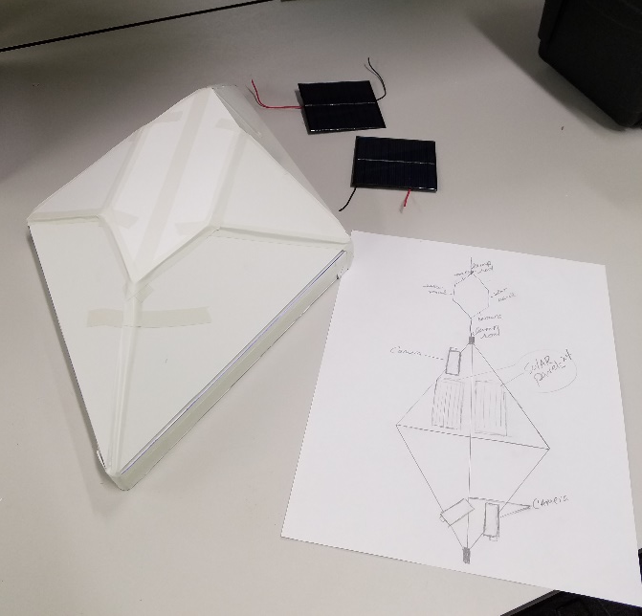
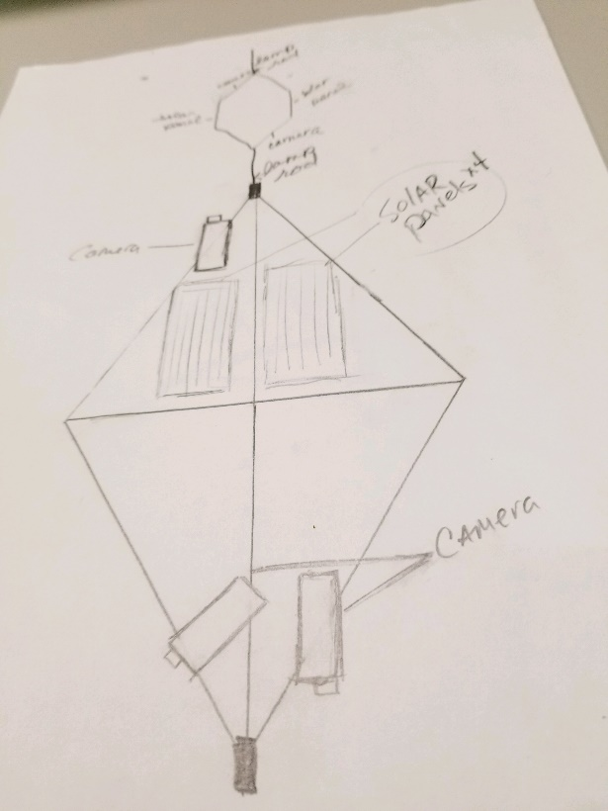

Slide 5
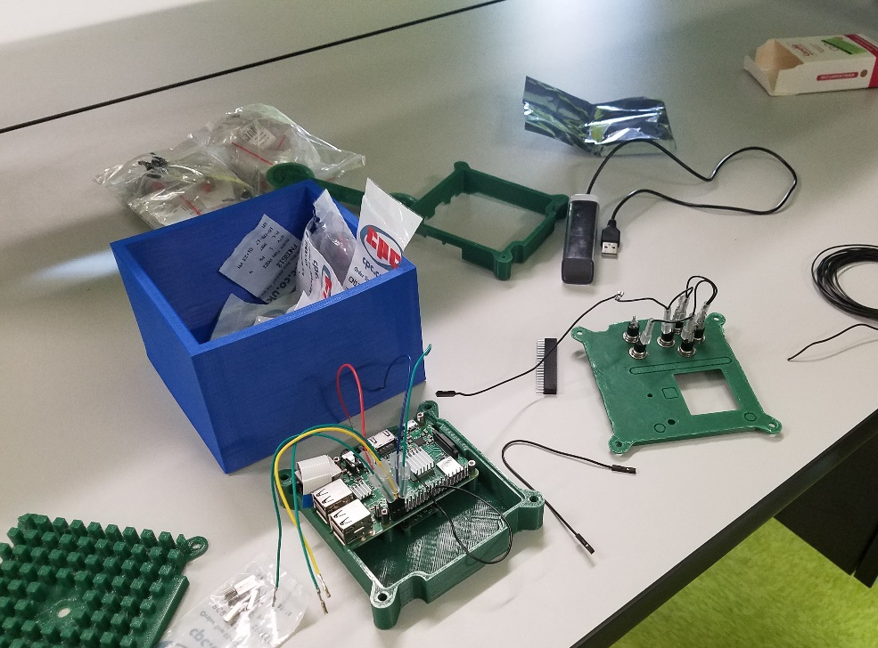
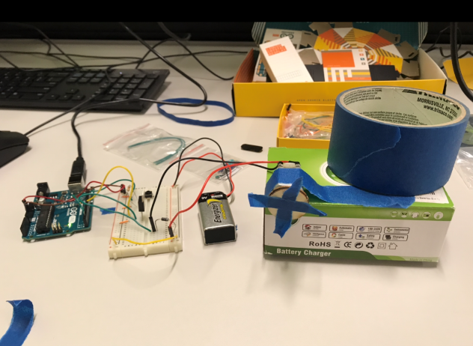
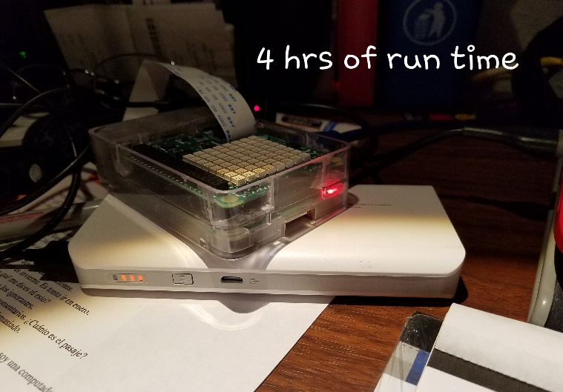
Adding the sensors and Cameras

Slide 6
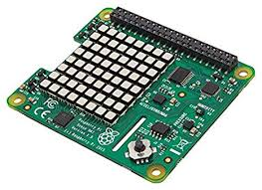
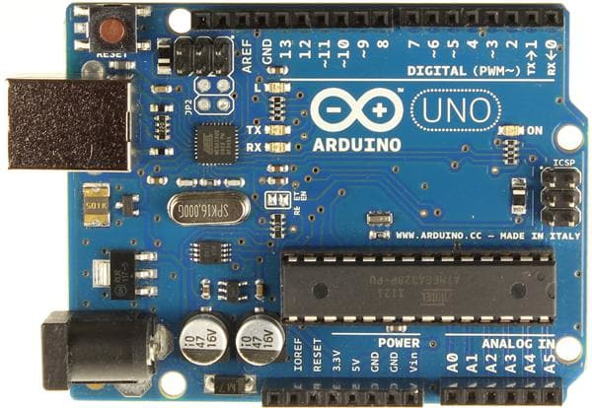
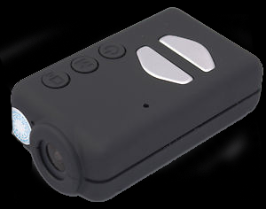
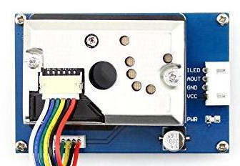
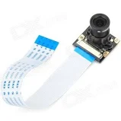
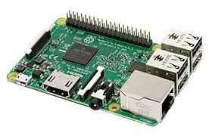
Hardware
Raspberry Pi with Sense Hat using built in sensors, Arduino with dust and gas detection sensors.
Two Mobius 1080p cameras, One upward facing camera for the capture of the balloon burst event, and another facing down to earth for altitude captures, onboard pi camera for still shots

Slide 7
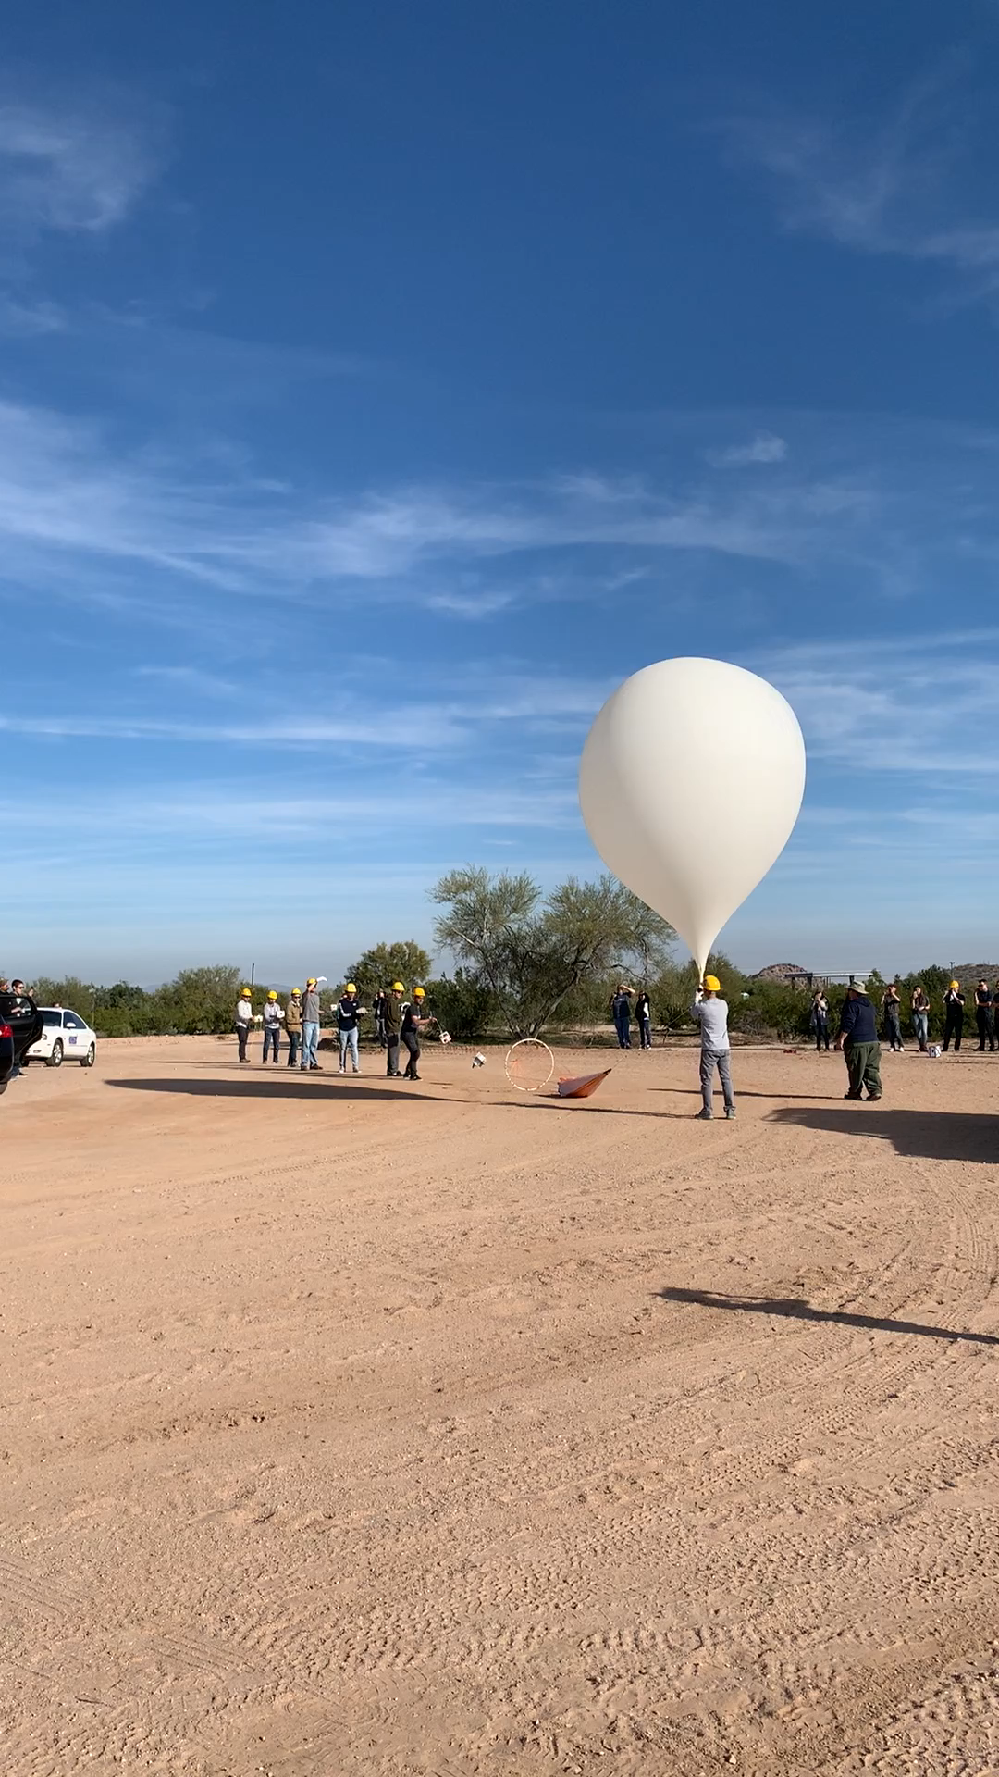
Launch Video of Flight

Slide 8
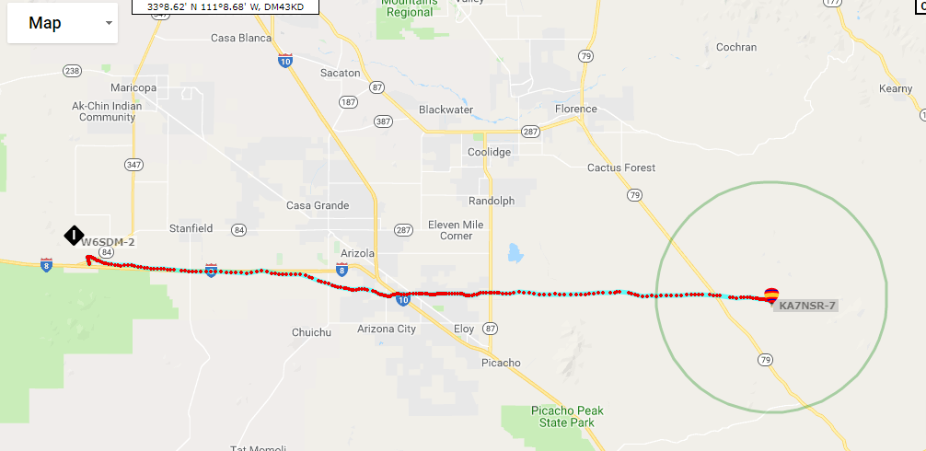
Flight Path

Slide 9
Lessons Learned from this Flight
Battery backup measures .
Soldering to insure electrical connections.
Separate power supplies, so other systems will continue to operate in case of a battery failure.
Night prior to launch, we ensure all connections are soldered or hardwired correctly, and batteries are fully charged.
Leave the hotel with the caravan, leaves enough time in the case of a major issue arising before launch.
Monitors and proper monitoring equipment brought to the launch site.

Slide 10
What Failed on this Flight
A solar panel wire came loose on launch, losing the generating power for the batteries.
Batteries drained within minutes of launch, and all systems failed to properly boot-up and initialize.
As the batteries failed, power to the cameras also failed, and we only recorded about half the flight footage.
We had a total system power failure due to the solar panels not generating power to the rechargeable batteries.
Cameras might have drained faster due to cold issues also, moving to the inside of payload and having dedicated power supply on next flight will have to be implemented.

Slide 11
ENGINEERING LESSONS
Soldering lessons to finalize sensor builds and connections
Payload conception, prototyping, and design
Coding for the sensors
Electrical wiring both using diagrams and experimentation
Research and development for and of various payload components and including payload structure, material, solar and sensors.
Communication skills in both group and presentation settings
Testing of materials for strength under various levels of temperature.

Slide 12
What did we personally learn this semester and take away from this class.
Michael Cabrera: I learned to have back-ups for back-ups, never assume its all going to work in the air as on the ground, test…test… test !! Keep our cameras on the inside of the payload, insulated.
Pam Cabrera: I learned to start things A.S.A.P. if possible
Peter Mwangi: I worked on the programming of the raspberry pi
Daniel Barkley: I learned how to wire an Arduino and a dust collector
Julian Madrid: I learned how to program using raspberry pi and Arduino.
Clayton Wood: I learned how to 3d print and solder
Angelo Navoa: I learned basic fundamentals of circuits and how to code to make things work

Slide 13
Special Thanks to…
Arizona Space Grant Consortium
ANSR
Susan Brew
Stephen Thomas
Dr. Wayne Pryor
Central Arizona College

